Slide 1


Python Programming Ⅰ
week 3

Slide 2
Python: Control Flow if Statement
Notes:
안녕하세요, 송용욱입니다.
이 동영상에서는 ~을 주제로 배워 보겠습니다.

Slide 3
Topic Structure
Task | Single Value | Multiple Values | numpy, pandas
Presentation (value, variable) | int, float, string, boolean | list, tuple, dictionary, set | ndarray, Series, DataFrame
Operation (algebra) | expressions | operations, mutable operations | expressions, get, set, reshape, …
Control flow | if for while
Use and reuse | Functions Standard libraries Modules and Packages
Input and output | Standard I/O File I/O |  | Standard I/O File I/O CSV, Excel

Slide 4
Learning Objectives
Control Flow
if statement
if
if-else
if-elif-else
if-elif-elif-else
if-elif-elif

Slide 5
Control Flow
A series of statements are executed by Python in exact top-down order.
What if you wanted to change the flow of how it works?
For example, you want the program to take some decisions and do different things depending on different situations, such as printing 'Good Morning' or 'Good Evening' depending on the time of the day?
This is achieved using control flow statements.
There are three control flow statements in Python - if, for and while.

Slide 6
Categories of Control Flow
Sequence
Left-to-right, and top-down
Division
if
Repetition
while, for

Slide 7
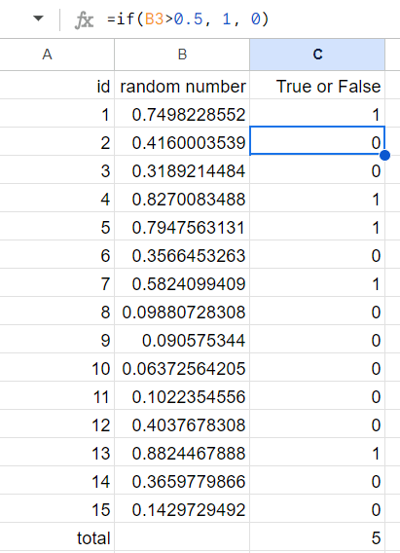
Division
Conditionally,
Do something
Or, do something else

Slide 8
Learning Objectives
Control Flow
if statement
if
if-else
if-elif-else
if-elif-elif-else
if-elif-elif

Slide 9
The if statement
The if statement is used to check a condition: if the condition is true, we run a block of statements (called the if-block), else we process another block of statements (called the else-block).
The else clause is optional.

Slide 10
Syntax of if Statement
if expression1:
statements1
elif expression2: # optional
statements2 # optional
elif expression3: # optional
statements3 # optional
… # optional
else: # optional
statementsN # optional

Slide 11
Variation: if
if expression1:
statements1
elif expression2: # optional
statements2 # optional
elif expression3: # optional
statements3 # optional
… # optional
else: # optional
statementsN # optional

Slide 12
Variation: if-else
if expression1:
statements1
elif expression2: # optional
statements2 # optional
elif expression3: # optional
statements3 # optional
… # optional
else: # optional
statementsN # optional

Slide 13
Variation: if-elif-else
if expression1:
statements1
elif expression2: # optional
statements2 # optional
elif expression3: # optional
statements3 # optional
… # optional
else: # optional
statementsN # optional

Slide 14
Variation: if-elif-elif-else
if expression1:
statements1
elif expression2: # optional
statements2 # optional
elif expression3: # optional
statements3 # optional
… # optional
else: # optional
statementsN # optional

Slide 15
Variation: if-elif-elif
if expression1:
statements1
elif expression2: # optional
statements2 # optional
elif expression3: # optional
statements3 # optional
… # optional
else: # optional
statementsN # optional

Slide 16
Indentation
Indentation
Block
Leading whitespace (spaces and tabs; indentation) at the beginning of the logical line is used to determine the indentation level of the logical line, which in turn is used to determine the grouping of statements.
This means that statements which go together must have the same indentation.
Each such set of statements is called a block.
if expression1:
statements1
elif expression2:
statements2
elif expression3:
statements3
…
else:
statementsN

Slide 17
Learning Objectives
Control Flow
if statement
if
if-else
if-elif-else
if-elif-elif-else
if-elif-elif

Slide 18
Flow Diagram: if
if expression:
statements
expression
If expression is true
If expression is false
statements

Slide 19
Control Flow in if
if expression1:
statements1

Slide 20
Control Flow in if
if expression1:
statements1

Slide 21
Control Flow in if
if expression1: # True
statements1

Slide 22
Control Flow in if
if expression1: # True
statements1

Slide 23
Control Flow in if
if expression1: # True
statements1
# Terminate

Slide 24
Control Flow in if
if expression1: # False
statements1

Slide 25
Control Flow in if
if expression1: # False
statements1
# Terminate

Slide 26
Indentation
if expression:
statements
expression
If expression is true
If expression is false
statements

Slide 27
Example: if
n = 10
if n % 2 == 0:
print(f"{n} is even.")

Slide 28
Example: Indentation
n = 10
if n % 2 == 0:
print(f"{n} is even.")
>>>
print(f"{n} is even.")
^
IndentationError: expected an indented block

Slide 29
Example: if
iAge = 19
if iAge >= 18:
print("You have the right to vote.")

Slide 30
Digression: input(prompt)
input("Type your age ... ")
sAge = input("Type your age ... ")
print("You typed: ", sAge)
print(sAge + 10)
print(int(aAge) + 10)
sAge = input("Type your age ... ")
sName = input("Type your name ... ")
print("You typed: ", sAge, sName)
# “내 나이가 10살이라면, 당신은 나보다 몇 살 많다” 프로그램을 작성하라

Slide 31
Digression: input(prompt)
myage = 10
diff = myage - int(sAge)
if diff > 0:
print(f＇저는 {myage}인데요,’)
print(f'저보다 {diff}살이 어리시군요’)
else :
print(f＇저는 {myage}인데요,’)
print(f'저보다 {-diff}살이 많으시군요’)
print(f’100살이 평균수명이면 {100-int(aAge)}년 남으셨네요’)

Slide 32

Quiz 2
Going Dutch

Slide 33
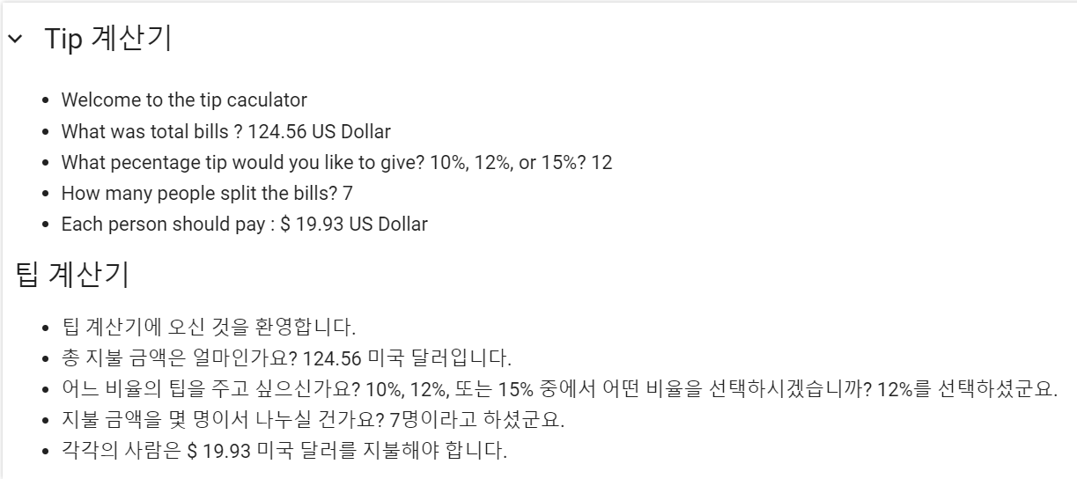
Quiz 2

Slide 34
Example: if
sAge = input("Type your age ... ")
if sAge >= 18:
print("You have the right to vote.")
>>>
if sAge >= 18:
TypeError: '>=' not supported between instances of 'str' and 'int'

Slide 35
Example: if
sAge = input("Type your age ... ")
if sAge >= "18":
print("You have the right to vote.")
>>>
Type your age ... 23
You have the right to vote.
>>>
Type your age ... 1
>>>
Type your age ... 6
You have the right to vote. ← Lexicographical Order

Slide 36
Digression: input(prompt) & int( )
sAge = input("Type your age ... ")
print("You typed: {sAge}")
print(f"You typed: {sAge}, has a data type {type(sAge)}")
iAge = int(sAge)
print(f"Converted: {iAge}, has a data type {type(iAge)}")
>>>
Type your age ... 23
You typed: {sAge} You typed: 23, has a data type <class 'str’>
Converted: 23, has a data type <class 'int'>

Slide 37
Digression: input(prompt) & int( )
sAge = input("Type your age ... ")
print("You typed: {0:d}".format(sAge))
>>>
print("You typed: {0:d}".format(sAge))
ValueError: Unknown format code 'd' for object of type 'str'

Slide 38
Digression: input(prompt) & float( )
s = input("Type a number ... ")
f = float(s)
d = round(f)
print("Round of {0:f} is {1:d}.".format(f, d))
>>>
Type a number ... 1.5
Round of 1.500000 is 2.
>>>
Type a number ... 2.5
Round of 2.500000 is 2. ← Round half to even

Slide 39
Example: if
sAge = input("Type your age ... ")
iAge = int(sAge)
if iAge >= 18:
print("You have the right to vote.")
>>>
Type your age ... 23
You have the right to vote.
>>>
Type your age ... 1
>>>
Type your age ... 6
← Numeric Order

Slide 40
Example: if
s = input("Type a number ... ")
n = int(s)
if n % 2 == 0:
print(f“{n} is even.")
n = int(input("Type a number ... "))
if n % 2 == 0:
print(f"{n} is even.")

Slide 41
Learning Objectives
Control Flow
if statement
if
if-else
if-elif-else
if-elif-elif-else
if-elif-elif

Slide 42
Flow Diagram: if-else
if expression:
statements1
else:
statements2
expression
If expression is true
If expression is false
statements1
statements2

Slide 43
Control Flow in if-else
if expression1:
statements1
else:
statementsN

Slide 44
Control Flow in if-else
if expression1:
statements1
else:
statementsN

Slide 45
Control Flow in if-else
if expression1: # True
statements1
else:
statementsN

Slide 46
Control Flow in if-else
if expression1: # True
statements1
else:
statementsN

Slide 47
Control Flow in if-else
if expression1: # True
statements1
else:
statementsN
# Terminate

Slide 48
Control Flow in if-else
if expression1: # False
statements1
else:
statementsN

Slide 49
Control Flow in if-else
if expression1: # False
statements1
else:
statementsN

Slide 50
Control Flow in if-else
if expression1: # False
statements1
else:
statementsN
# Terminate

Slide 51
Indentation
if expression:
statements1
else:
statements2
expression
If expression is true
If expression is false
statements1
statements2

Slide 52
Example: if-else
n = 11
if n % 2 == 0:
print(f"{n} is even.")
else:
print(f"{n} is odd.")

Slide 53
Practice: if-else
Make a Python program which:
Step 1) inputs an integer, n.
Step 2) prints out whether n is odd or even.
n = int(input())
n % 2 == 0
True
False
print('n is even')
print('n is odd')

Slide 54
Example: if-else
n = int(input("Type a number ... "))
if n % 2 == 0:
print(f"{n} is even.")
else:
print("{n} is odd.")

Slide 55
Example: if-else
iAge = 19
if iAge >= 18:
print("You have the right to vote.")
else:
print("You don't have the right to vote.")

Slide 56
Example: if-else
iAge = int(input("Type your age ... "))
if iAge >= 18:
print("You have the right to vote.")
else:
print("You don't have the right to vote.")

Slide 57
Example: if-else
n = 121
d = 11
if n % d == 0:
print("The denominator {0:d} divides"
" the numerator {1:d} evenly.".format(d, n))
else:
print("The denominator {0:d} does not divide"
" the numerator {1:d} evenly.".format(d, n))

Slide 58
Example: if-else
n = int(input("Type a numerator ... "))
d = int(input("Type a denominator ... "))
if n % d == 0:
print("The denominator {0:d} divides"
" the numerator {1:d} evenly.".format(d, n))
else:
print("The denominator {0:d} does not divide"
" the numerator {1:d} evenly.".format(d, n))

Slide 59
Example: if-else
iAge = int(input("Type your age ... "))
if 13 <= iAge <= 19:
print("You are a teenager.")
else:
print("You are not a teenager.")

Slide 60
Example: if-else
iAge = int(input("Type your age ... "))
if 13 > iAge or iAge > 19:
print("You are not a teenager.")
else:
print("You are a teenager.")

Slide 61
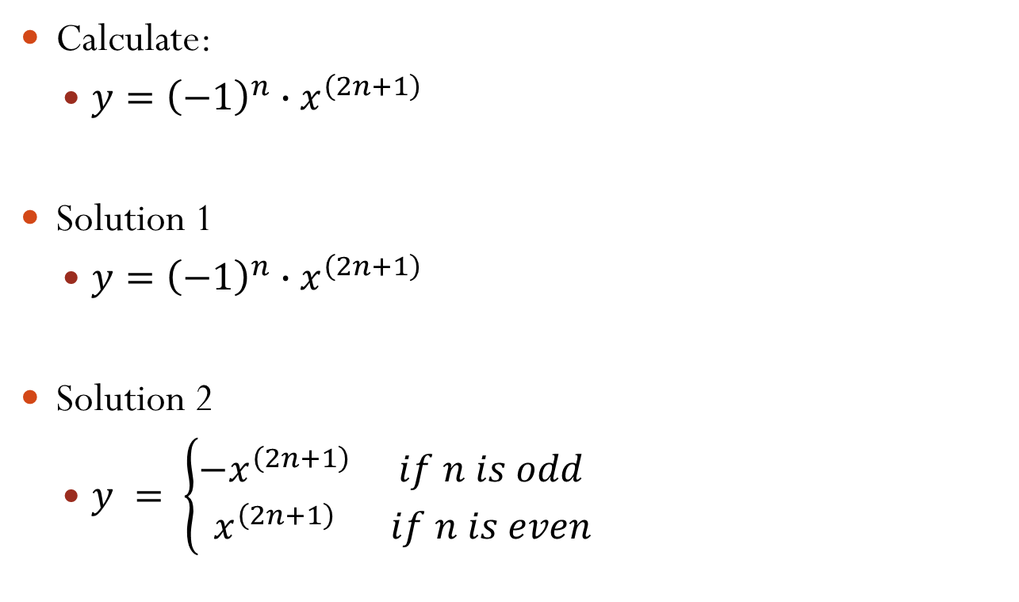
Example: if-else
Calculate:
$y={\left(−1\right)}^{n}∙x^{\left(2n+1\right)}$
Solution 1
$y={\left(−1\right)}^{n}∙x^{\left(2n+1\right)}$
Solution 2
$y = \left\{\begin{matrix}−x^{\left(2n+1\right)} & if n is odd \\ x^{\left(2n+1\right)} & if n is even\end{matrix}\right.$

Slide 62

Q&A start

Slide 63
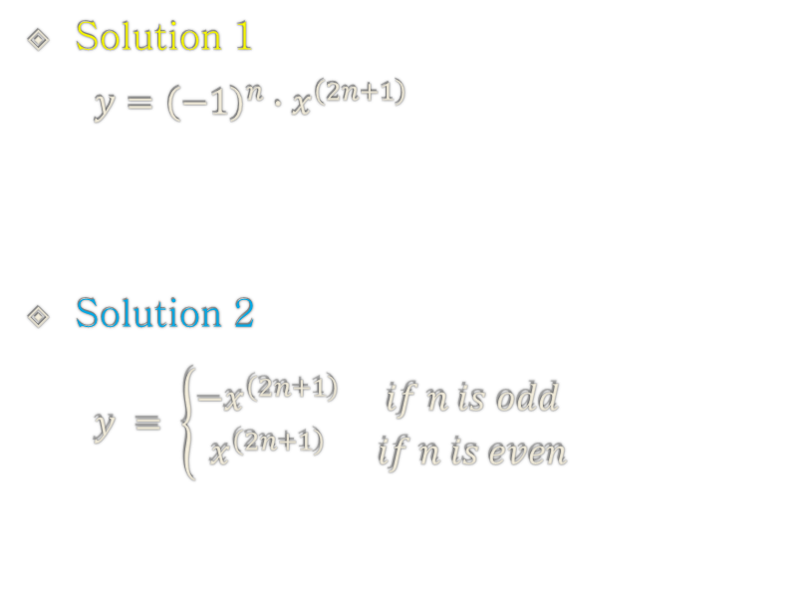
Example: if-else
# Solution 1
x = 2
n = 1
y = ((-1) ** n) * (x ** (2 * n + 1))
print(y)
# Solution 2
x = 2
n = 1
if n % 2 == 1:
y = -(x ** (2 * n + 1))
else:
y = x ** (2 * n + 1)
print(y)
Solution 1
$$y={\left(−1\right)}^{n}∙x^{\left(2n+1\right)}$$
Solution 2
$$y = \left\{\begin{matrix}−x^{\left(2n+1\right)} & if n is odd \\ x^{\left(2n+1\right)} & if n is even\end{matrix}\right.$$

Slide 64
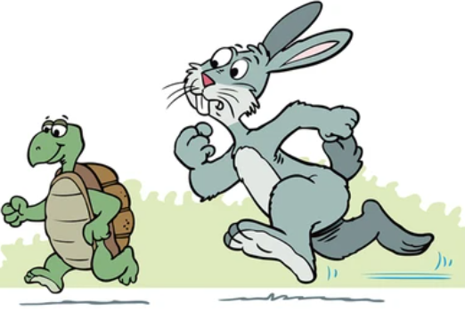
Which solution is better? Why?
# Solution 1
import time
x = 2
n = 1
t1 = time.time()
for i in range(1, 10000000):
y = ((-1) ** i) * (x ** (2 * n + 1))
t2 = time.time()
print(y)
print(t2 - t1)
# Solution 2
import time
x = 2
n = 1
t1 = time.time()
for i in range(1, 10000000):
if n % 2 == 1:
y = -(x ** (2 * n + 1))
else:
y = x ** (2 * n + 1)
t2 = time.time()
print(y)
print(t2 - t1)

Slide 65
Learning Objectives
Control Flow
if statement
if
if-else
if-elif-else
if-elif-elif-else
if-elif-elif

Slide 66
Flow Diagram: if-elif-else
if expression1:
statements1
elif expression2:
statements2
elif expression3:
statements3
…
else:
statementsN
expression1
False
True
statements1
expression2
False
True
statements2
expression3
False
True
statements3
…
statementsN

Slide 67
Control Flow in if-elif-else
if expression1:
statements1
elif expression2:
statements2
else:
statementsN

Slide 68
Control Flow in if-elif-else
if expression1:
statements1
elif expression2:
statements2
else:
statementsN

Slide 69
Control Flow in if-elif-else
if expression1: # True
statements1
elif expression2:
statements2
else:
statementsN

Slide 70
Control Flow in if-elif-else
if expression1: # True
statements1
elif expression2:
statements2
else:
statementsN

Slide 71
Control Flow in if-elif-else
if expression1: # True
statements1
elif expression2:
statements2
else:
statementsN
# Terminate

Slide 72
Control Flow in if-elif-else
if expression1: # False
statements1
elif expression2:
statements2
else:
statementsN

Slide 73
Control Flow in if-elif-else
if expression1: # False
statements1
elif expression2:
statements2
else:
statementsN

Slide 74
Control Flow in if-elif-else
if expression1: # False
statements1
elif expression2: # True
statements2
else:
statementsN

Slide 75
Control Flow in if-elif-else
if expression1: # False
statements1
elif expression2: # True
statements2
else:
statementsN

Slide 76
Control Flow in if-elif-else
if expression1: # False
statements1
elif expression2: # True
statements2
else:
statementsN
# Terminate

Slide 77
Control Flow in if-elif-else
if expression1: # False
statements1
elif expression2: # False
statements2
else:
statementsN

Slide 78
Control Flow in if-elif-else
if expression1: # False
statements1
elif expression2: # False
statements2
else:
statementsN

Slide 79
Control Flow in if-elif-else
if expression1: # False
statements1
elif expression2: # False
statements2
else:
statementsN
# Terminate

Slide 80
Indentation
if expression1:
statements1
elif expression2:
statements2
elif expression3:
statements3
…
else:
statementsN
expression1
False
True
statements1
expression2
False
True
statements2
expression3
False
True
statements3
…
statementsN

Slide 81
Example: if-elif-else
n = int(input("Type a number ... "))
if n % 3 == 0:
print("The remainder is 0.")
elif n % 3 == 1:
print("The remainder is 1.")
else:
print("The remainder is 2.")
# Alternative solution
n = int(input("Type a number ... "))
print("The remainder is {0:d}.".format(n % 3))

Slide 82
Example: if-elif-else
sSSN = input("Type your SSN ... ")
if sSSN[6] == "1":
print("You are male born in the 20th century.")
elif sSSN[6] == "2":
print("You are female born in the 20th century.")
elif sSSN[6] == "3":
print("You are male born in the 21st century.")
elif sSSN[6] == "4":
print("You are female born in the 21st century.")
else:
print("Unknown SSN.")

Slide 83
Quiz 3
BMI Calculation

Slide 84

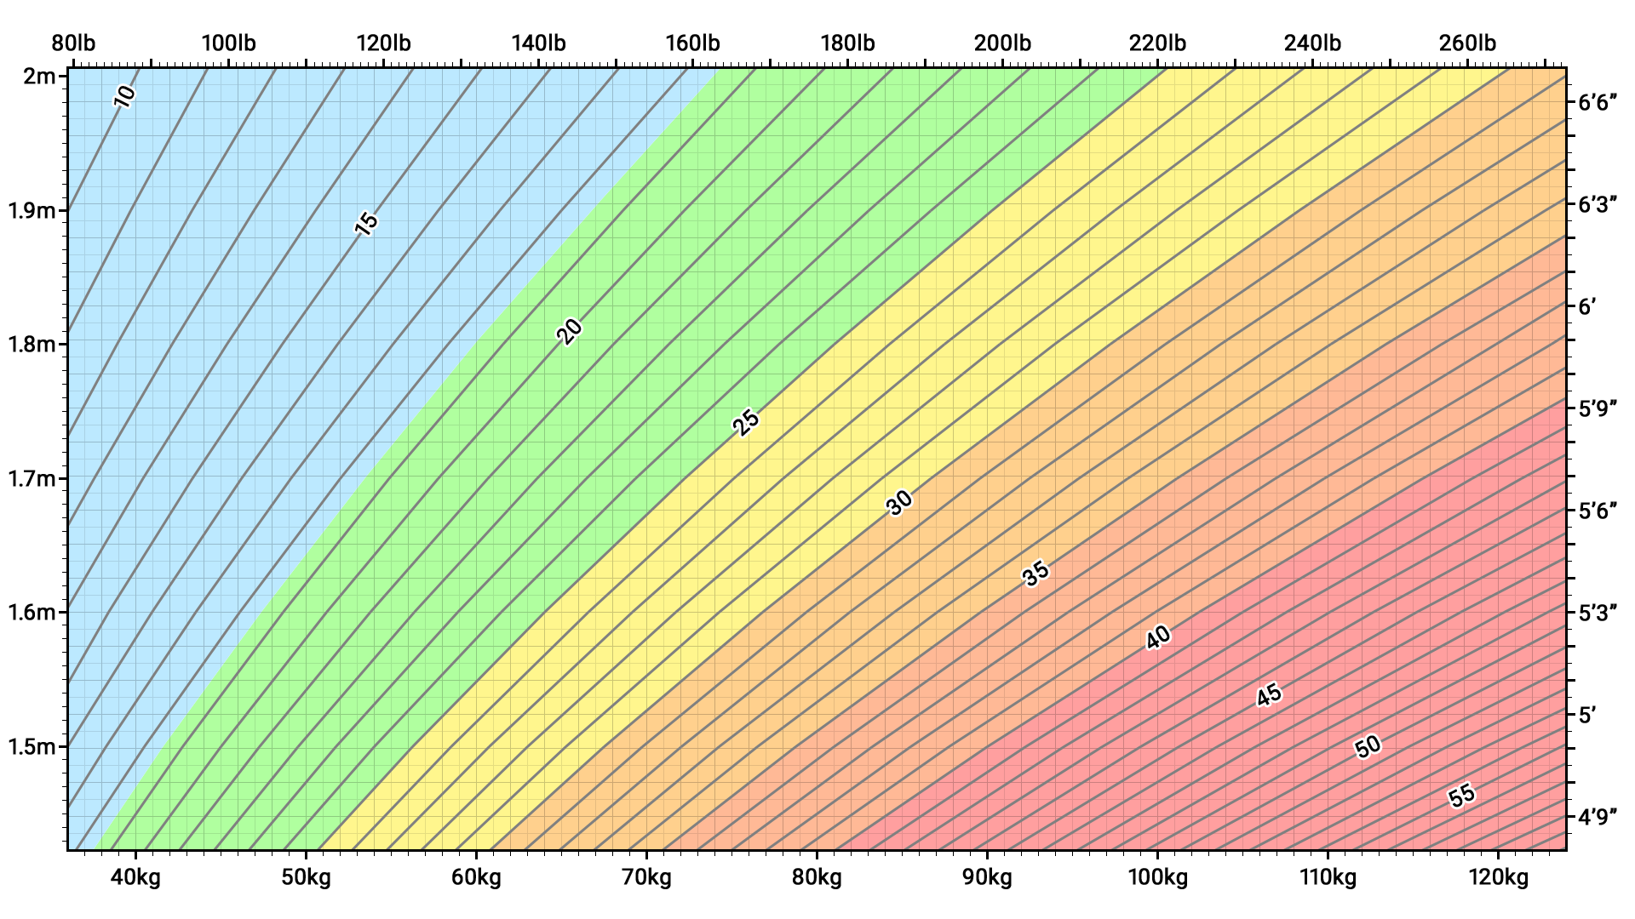
Quiz 3_당신의 키와 몸무게로 BMI를 계산하라
https://en.wikipedia.org/wiki/Body_mass_index
underweight
normal weight
overweight
moderately obese
severely obese
very severely obese.

Slide 85
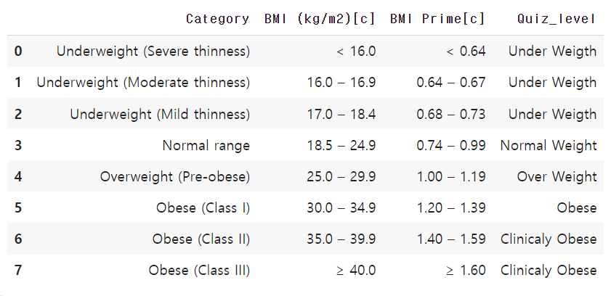
Quiz 3_당신의 키와 몸무게로 BMI를 계산하라
import requests
from bs4 import BeautifulSoup
import pandas as pd
# Replace this URL with the actual URL of the Wikipedia page
url = "https://en.wikipedia.org/wiki/Body_mass_index"
# Fetch the page content
response = requests.get(url)
soup = BeautifulSoup(response.content, 'html.parser')
# Find the BMI table by inspecting the Wikipedia page HTML
table = soup.find('table', class_='wikitable')
# Read the table data using pandas
df = pd.read_html(str(table))[0]
df
df['Quiz_level'] = ['Under Weigth', 'Under Weigth', 'Under Weigth',
'Normal Weight', 'Over Weight', 'Obese',
'Clinicaly Obese', 'Clinicaly Obese']
df

Slide 86
Practice: if-elif-else
Make a Python program which:
Step 1) inputs user’s age, iAge.
Step 2) prints out:
‘You are a child.’ if iAge is less than or equal to 12.
‘You are a teenager.’ if iAge is between 13 and 19.
‘You are an adult.’ if iAge is greater than or equal to 20.
iAge = input()
iAge <= 12
False
True
print('child')
iAge <= 19
False
True
print('teenager')
print('adult')

Slide 87
Example: if-elif-else
iAge = int(input("Type your age ... "))
if iAge <= 12:
print("You are a child.")
elif 13 <= iAge <= 19:
print("You are a teenager.")
elif iAge >= 20:
print("You are an adult.")

Slide 88
Example: if-elif-else
iAge = int(input("Type your age ... "))
if iAge <= 12:
print("You are a child.")
elif 13 <= iAge <= 19:
print("You are a teenager.")
elif iAge >= 20:
print("You are an adult.")

Slide 89
Example: if-elif-else
iAge = int(input("Type your age ... "))
if iAge <= 12:
print("You are a child.")
elif 13 <= iAge <= 19:
print("You are a teenager.")
else:
print("You are an adult.")

Slide 90
Example: if-elif-else
iAge = int(input("Type your age ... "))
if iAge <= 12:
print("You are a child.")
elif 13 <= iAge <= 19:
print("You are a teenager.")
else:
print("You are an adult.")

Slide 91
Example: if-elif-else
iAge = int(input("Type your age ... "))
if iAge <= 12:
print("You are a child.")
elif iAge <= 19:
print("You are a teenager.")
else:
print("You are an adult.")

Slide 92
Number Guessing Game
Step 1) Player A가 1과 N 사이의 숫자 n를 생각한다.
Step 2) Player B가 숫자 g를 추측하여 부른다.
Step 3) g가 n과 같으면 Player B의 승리를 선언하고 종료한다.
Step 4) n이 g 보다 크면, Player A는 정답이 g 보다 크다고 이야기 한 후, Step 2)로 간다.
Step 5) n이 g 보다 작으면, Player A는 정답이 g 보다 작다고 이야기 한 후, Step 2)로 간다.

Slide 93
Example: if-elif-else
iNumber = 23
iGuess = int(input('Enter an integer: '))
if iGuess == iNumber:
print('Congratulations, you guessed it.')
print('(but you do not win any prizes!)')
elif iGuess < iNumber:
print('No, it is a little higher than that')
else:
print('No, it is a little lower than that')
iNumber = 23
iGuess = int(input())
iGuess == iNumber
False
True
print('Congratulations')
iGuess < iNumber
False
True
print('higher')
print('lower')

Slide 94
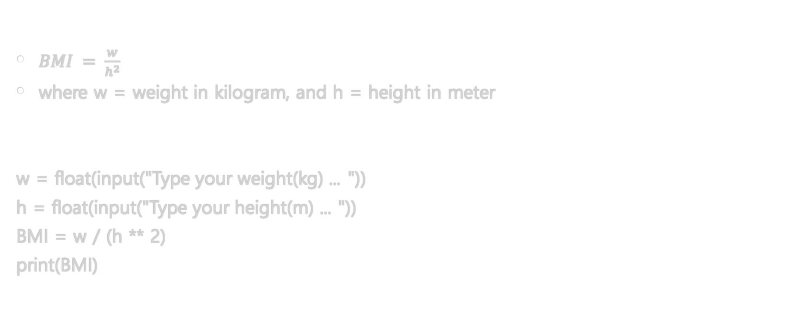
Digression: BMI (Body Mass Index)
$BMI = \frac{w}{h^{2}}$
where w = weight in kilogram, and h = height in meter
w = float(input("Type your weight(kg) ... "))
h = float(input("Type your height(m) ... "))
BMI = w / (h ** 2)
print(BMI)

Slide 95
Practice: BMI
Make a Python program as below:
Input user’s weight (in kilogram) and height (in meter),
calculate the BMI,
and print out:
‘underweight’ if BMI <= 18.5
‘normal weight’ if 18.5 < BMI < 25.0
‘overweight’ if 25.0 <= BMI < 30.0
‘obesity’ if 30.0 <= BMI

Slide 96
Learning Objectives
Control Flow
if statement
if
if-else
if-elif-else
if-elif-elif-else
if-elif-elif

Slide 97
Control Flow in if-elif-elif-else
if expression1:
statements1
elif expression2:
statements2
elif expression3:
statements3
else:
statementsN

Slide 98
Control Flow in if-elif-elif-else
if expression1:
statements1
elif expression2:
statements2
elif expression3:
statements3
else:
statementsN

Slide 99
Control Flow in if-elif-elif-else
if expression1: # True
statements1
elif expression2:
statements2
elif expression3:
statements3
else:
statementsN

Slide 100
Control Flow in if-elif-elif-else
if expression1: # True
statements1
elif expression2:
statements2
elif expression3:
statements3
else:
statementsN

Slide 101
Control Flow in if-elif-elif-else
if expression1: # True
statements1
elif expression2:
statements2
elif expression3:
statements3
else:
statementsN
# Terminate

Slide 102
Control Flow in if-elif-elif-else
if expression1: # False
statements1
elif expression2:
statements2
elif expression3:
statements3
else:
statementsN

Slide 103
Control Flow in if-elif-elif-else
if expression1: # False
statements1
elif expression2:
statements2
elif expression3:
statements3
else:
statementsN

Slide 104
Control Flow in if-elif-elif-else
if expression1: # False
statements1
elif expression2: # True
statements2
elif expression3:
statements3
else:
statementsN

Slide 105
Control Flow in if-elif-elif-else
if expression1: # False
statements1
elif expression2: # True
statements2
elif expression3:
statements3
else:
statementsN

Slide 106
Control Flow in if-elif-elif-else
if expression1: # False
statements1
elif expression2: # True
statements2
elif expression3:
statements3
else:
statementsN
# Terminate

Slide 107
Control Flow in if-elif-elif-else
if expression1: # False
statements1
elif expression2: # False
statements2
elif expression3:
statements3
else:
statementsN

Slide 108
Control Flow in if-elif-elif-else
if expression1: # False
statements1
elif expression2: # False
statements2
elif expression3:
statements3
else:
statementsN

Slide 109
Control Flow in if-elif-elif-else
if expression1: # False
statements1
elif expression2: # False
statements2
elif expression3: # True
statements3
else:
statementsN

Slide 110
Control Flow in if-elif-elif-else
if expression1: # False
statements1
elif expression2: # False
statements2
elif expression3: # True
statements3
else:
statementsN

Slide 111
Control Flow in if-elif-elif-else
if expression1: # False
statements1
elif expression2: # False
statements2
elif expression3: # True
statements3
else:
statementsN
# Terminate

Slide 112
Control Flow in if-elif-elif-else
if expression1: # False
statements1
elif expression2: # False
statements2
elif expression3: # False
statements3
else:
statementsN

Slide 113
Control Flow in if-elif-elif-else
if expression1: # False
statements1
elif expression2: # False
statements2
elif expression3: # False
statements3
else:
statementsN

Slide 114
Control Flow in if-elif-elif-else
if expression1: # False
statements1
elif expression2: # False
statements2
elif expression3: # False
statements3
else:
statementsN
# Terminate

Slide 115
Learning Objectives
Control Flow
if statement
if
if-else
if-elif-else
if-elif-elif-else
if-elif-elif

Slide 116
Control Flow in if-elif-elif
if expression1:
statements1
elif expression2:
statements2
elif expression3:
statements3

Slide 117
Control Flow in if-elif-elif
if expression1:
statements1
elif expression2:
statements2
elif expression3:
statements3

Slide 118
Control Flow in if-elif-elif
if expression1: # True
statements1
elif expression2:
statements2
elif expression3:
statements3

Slide 119
Control Flow in if-elif-elif
if expression1: # True
statements1
elif expression2:
statements2
elif expression3:
statements3

Slide 120
Control Flow in if-elif-elif
if expression1: # True
statements1
elif expression2:
statements2
elif expression3:
statements3
# Terminate

Slide 121
Control Flow in if-elif-elif
if expression1: # False
statements1
elif expression2:
statements2
elif expression3:
statements3

Slide 122
Control Flow in if-elif-elif
if expression1: # False
statements1
elif expression2:
statements2
elif expression3:
statements3

Slide 123
Control Flow in if-elif-elif
if expression1: # False
statements1
elif expression2: # True
statements2
elif expression3:
statements3

Slide 124
Control Flow in if-elif-elif
if expression1: # False
statements1
elif expression2: # True
statements2
elif expression3:
statements3

Slide 125
Control Flow in if-elif-elif
if expression1: # False
statements1
elif expression2: # True
statements2
elif expression3:
statements3
# Terminate

Slide 126
Control Flow in if-elif-elif
if expression1: # False
statements1
elif expression2: # False
statements2
elif expression3:
statements3

Slide 127
Control Flow in if-elif-elif
if expression1: # False
statements1
elif expression2: # False
statements2
elif expression3:
statements3

Slide 128
Control Flow in if-elif-elif
if expression1: # False
statements1
elif expression2: # False
statements2
elif expression3: # True
statements3

Slide 129
Control Flow in if-elif-elif
if expression1: # False
statements1
elif expression2: # False
statements2
elif expression3: # True
statements3

Slide 130
Control Flow in if-elif-elif
if expression1: # False
statements1
elif expression2: # False
statements2
elif expression3: # True
statements3
# Terminate

Slide 131
Control Flow in if-elif-elif
if expression1: # False
statements1
elif expression2: # False
statements2
elif expression3: # False
statements3

Slide 132
Control Flow in if-elif-elif
if expression1: # False
statements1
elif expression2: # False
statements2
elif expression3: # False
statements3
# Terminate

Slide 133
Summary
Control Flow
if statement
if
if-else
if-elif-else
if-elif-elif-else
if-elif-elif

Slide 134
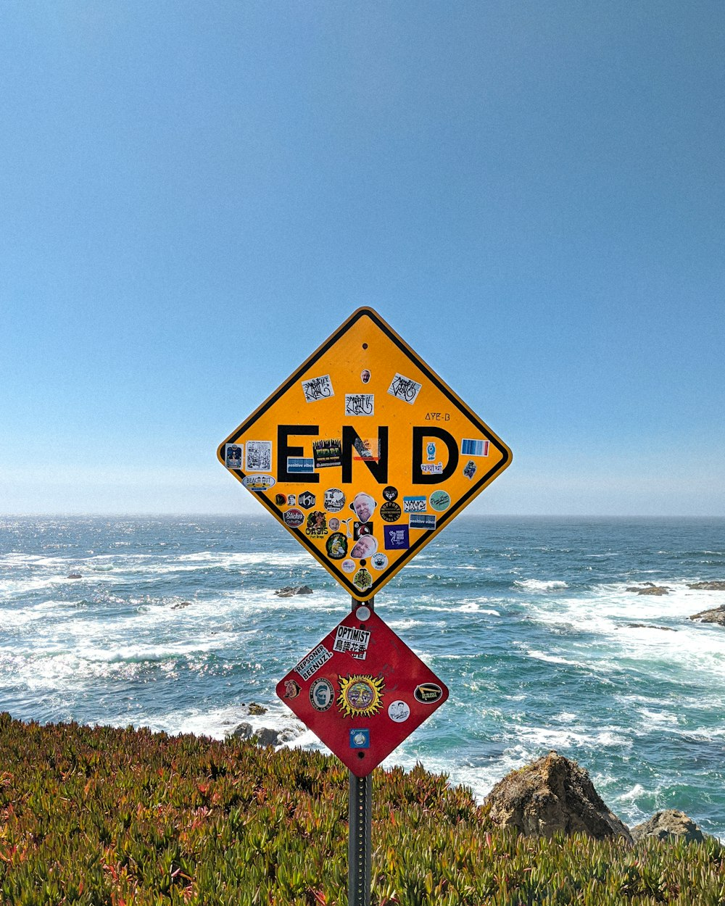
End of Python: Control Flow if Statement
Notes:
이상으로 ~에 대한 강의를 마치도록 하겠습니다.
감사합니다.

